Slide 1

Gaming & Learning? Taking a look beyond the book
College Teaching & Learning Conference

Slide 2


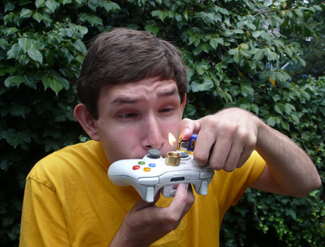

Who Plays

Slide 3

Do you play
How many of you play (or have played) video games?
If so, what types of games?

Slide 4
What do you think
What are some of your concerns about gaming?

Slide 5
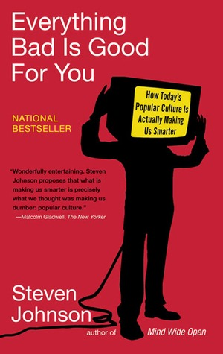
Cultural forms
Excerpts
“You have to shed your expectations about older cultural forms to make sense of the new.” (p. 39)

Slide 6
content
Excerpts
“…a false premise: that the intelligence of these games lies in their content, in the themes and characters they represent.” (p. 57)

Slide 7
Popular culture
Excerpts
“We need to think, talk, and listen. When we tell students that popular culture has no place in classroom discussions, we are signaling to them that what they learn in school has little to do with the things that matter to them at home.” (p. 229)

Slide 8
What do you think
What are some of your concerns about gaming?
What are some benefits of gaming?

Slide 9
Gaming & education
What connections, if any, do you see between video games/gaming and education?

Slide 10
Trial and error
Excerpts
“’You’re supposed to figure out what you’re supposed to do.’ You have to probe the depths of the game’s logic to make sense of it, and like most probing expeditions, you get results by trial and error, by stumbling across things, by following hunches.” (pp. 42-43)

Slide 11
Cognitive workout
Excerpts
“I think there is another way to assess the social virtue of pop culture, one that looks at media as a kind of cognitive workout, not as a series of life lessons.” (p. 14)

Slide 12
Intellectual nourishment
Excerpts
“The intellectual nourishment of reading books is so deeply ingrained in our assumptions that it’s hard to contemplate a different viewpoint.” (p. 18)
Let’s try...

Slide 13
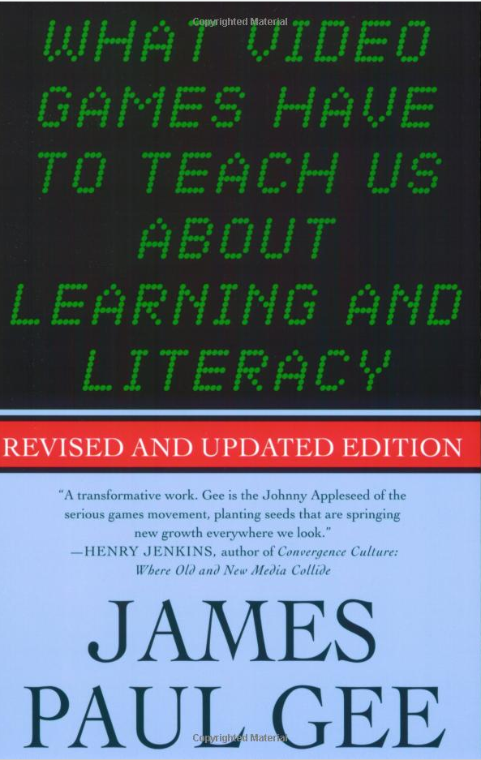
Assigned Reading
James Paul Gee

Slide 14

36 Learning Principles
Concentrated Sample
Cultural Models about Semiotic Domains
Design
Dispersed
Distributed
Incremental
Intertextual
“Material Intelligence”
Metalevel Thinking about Semiotic Domains
Ongoing Learning
“Regime of Competence”
Self-Knowledge
Situated Meaning
Subset
Text

Slide 15
36 Learning Principles
Achievement
Active, Critical Learning
Affinity Group
Amplification of Input
Bottom-up Basic Skills
Committed Learning
Cultural Models about Learning
Cultural Models about the World
Discovery
Explicit Information On-Demand and Just-In-Time
Identity
Insider
Intuitive Knowledge
Practice
Probing
“Psychosocial Moratorium”
Multimodal
Multiple Routes
Semiotic
Semiotic Domains
Transfer

Slide 16
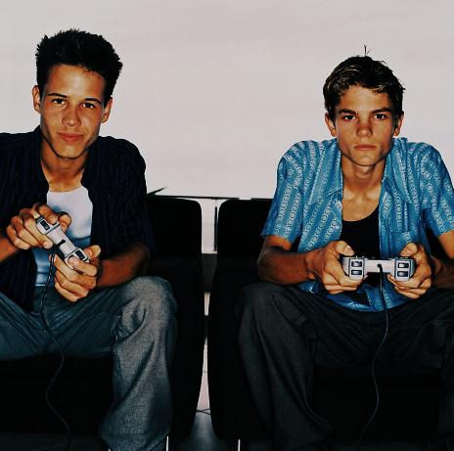


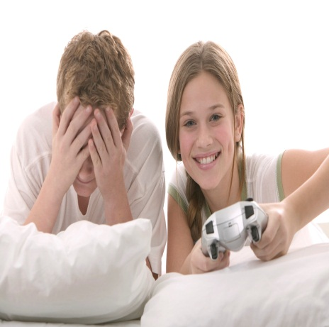
The Assignment
Qualitative Research
Paper Requirements
Option 1 - Interview a gamer
Option 2 - Play a game
Demographics
Questions
Findings
Discussion

Slide 17
Gaming research: Learning or wasting time?
Ingrida Barker

Slide 18

About me
Background:
English Language Arts teacher at a middle school level;
Teacher
Spanish I facilitator through WV Virtual School;
Currently, a principal of curriculum and instruction at River View High School and a doctorate student at

Slide 19


Pre-Reading views
I am not a gamer!
Decent understanding of the benefits of playing and creating the video games to build the skills of critical thinking and networked collaboration.
Views on gaming affected by my work with Globaloria guided by Dr. Idit Caperton, an avid advocate of student learning through not only playing the video games but also creating the games to teach others about the chosen concepts.
Networked world: everybody can benefit from the intelligence, creativity, or extraordinary achievements of their peers where there is no one leader, where masses can affect change in tremendously empowering way.

Slide 20
  Focus :
  Interview a gamer to evaluate his gaming experiences and explore the implications of my research on education and learning.
  Subject Demographics:
  Jason, male in his late twenties, grew up in southern West Virginia;
  Information technology specialist for the county schools;
  Changed his name after high school graduation to reflect his own uniqueness and to baffle his family members;
  Graduate of Cisco Systems Networking Academy without further pursuit of other formal education venues;
  Occasionally, the subject takes systems development courses from institutions like Harvard.
  Passion for video games; twenty years of gaming experience.

Slide 21


Observations from research
Ongoing, committed learning to retrieve the treasure at the end of the game.
Clear identification of the setting and the quest to accomplish following the internal and external grammars of the game;
Skillful navigation of the content as well as social practices and views established by the affinity groups.
Learning from mistakes and not being afraid to make them- “psychosocial moratorium” principle encourages players to take risks in the environment where real world consequences are lowered. (Gee, p. 222)

Slide 22

Implications for education
From Passive to Active Learning
Learning from Games
Games help players “understand and produce meanings in a particular semiotic domain” and “think about the domains at a ‘meta’ level as a complex system of interrelated parts.” (Gee, p. 25)
Critical, active learning in the virtual worlds of games forces gamers to make novel decisions to adapt to increasing levels of challenge and collaborate with others to build knowledge and skill levels.

Slide 23

What we can do:
Let students practice skills continuously, providing frequent feedback;
Let the students learn from not succeeding at learning the concepts initially and persevere in mastering concepts as they become more challenging.
Provide learning activities where students have to adapt and change their skills when facing novel situations thinking anew about the skills that have become unconscious.

Slide 24
references
Gee, J. P. (2012). How complex gaming environments can help young people solve problems and innovate in a world that is constantly changing. Retrieved from http://vimeo.com/15732568
Gee, J. P. (2007). What video games have to teach us about learning and literacy. New York: Palgrave Macmillan.
Globaloria. (2012). What is Globaloria? Retrieved from http://www.viddler.com/v/bfe68f00
Johnson, S. (2006). Everything bad is good for you: How today’s popular culture is actually making us smarter. New York: Riverhead Books.
Microsoft. (2012). Microsoft Clip Art.

